Slide 1

Swaap: Labs 22
Bobby Hall, Team Lead
Chad Rutherford, iOS
Roberto Banbanaste, Web
Sierra Curtis, Web
Tristan Depew, Web
Corey Gumbs, Web
Erica Ingram, Web
Click Here to View Swaap's Product Vision Document
Notes:
Hello there, I'm Erica Ingram from the Swaap team in Labs 22. Welcome to the final delivery presentation of Swaap. Today, we’ll go through a brief retrospective of the last eight weeks spent in Labs on a project called Swaap, a contact-trading app. (Video of this presentation found at https://youtu.be/ucvKVrCtKtY)

Slide 2
Problem Addressed: Inconsistent user experience
Release Canvas I:
Link updating/creation may be confusing for the user, refactor to enhance ease of use (WEB)
Preferred contact shows as “@@swaapApp” if user hasn’t selected one
User isn't warned before they delete a contact (just deletes on click) (iOS & WEB)
Token expiration needs to be fixed (WEB)
Profile picture alignment is off (WEB)
Mobile app and web portal aren't displaying the same information (iOS & WEB)
Changing birthdate on app won't update birthdate on the web portal.
Job title, location, tagline, bio section is not included on the Web Portal
Profile information on Mobile app is left out unless you're editing
Release Canvas II:
Unclear how to add and manage contacts
Users have no way to sort/filter their contacts for easy/quick access
Non-Swaap users have no access to your information
Map of where you met your connection
User onboarding
Notes:
The biggest problem and the one we paid most attention to was that Swaap did not have a very consistent user experience. Considering this wasn't a greenfield project and we found a ton of bugs and potential things to fix, we decided it would be best if, for our first release canvas, we focused on making the web and iOS user experiences more consistent and clean. The second canvas we designated for a new feature and ended up evolving significantly from initial idea to final implementation.

Slide 3
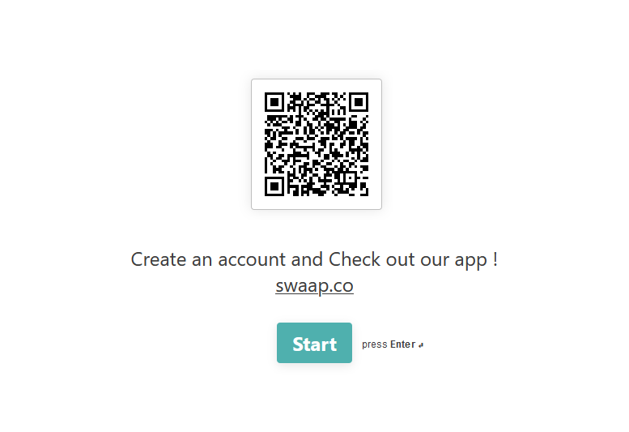
User Research
https://bobbyleonhalljr.typeform.com/to/wVhldA
60+ years old
Retired
Suggestions:
No changes
26-45 years old
Software Developer
Suggestions:
Scan QR code & auto-create connection request
Deciding who has camera & who has QR code clunky
App only saves time if both parties already have app
Notes:
We did several user personas and updated the competitor research, adding six plus competitors that we analyzed. Then despite not having a UX designer, we did create a survey to ask people to try out our app and answer some questions to give us some direction for which features we should fix or develop first. With so many possible directions to go in given a limited time, what can we do that would have the maximum best impact on our users? We got two responses from the two people you see represented here, so it wasn't terribly informative. We ended up presenting this issue to the stakeholder and getting feedback on direction from the stakeholder.

Slide 4
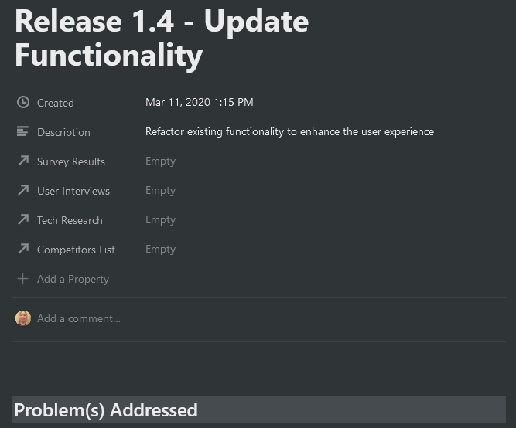
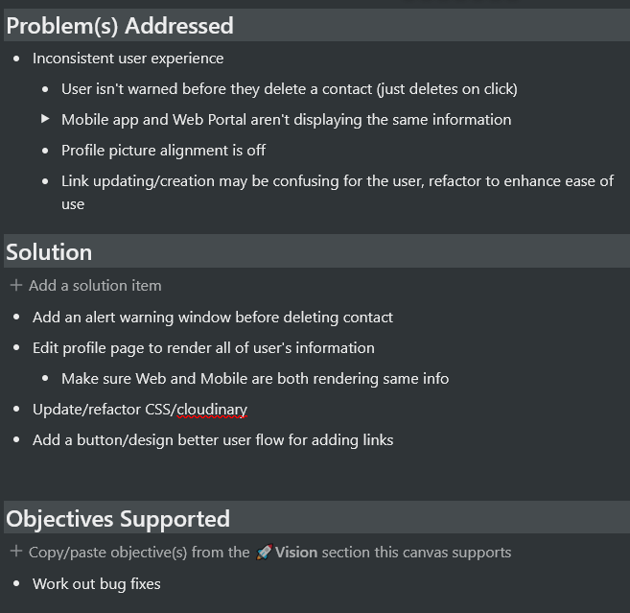
First Release Canvas
Notes:
As I said previously, our first release canvas was mostly bug fixes and resolved the following issues under the umbrella of an inconsistent user experience.

Slide 5
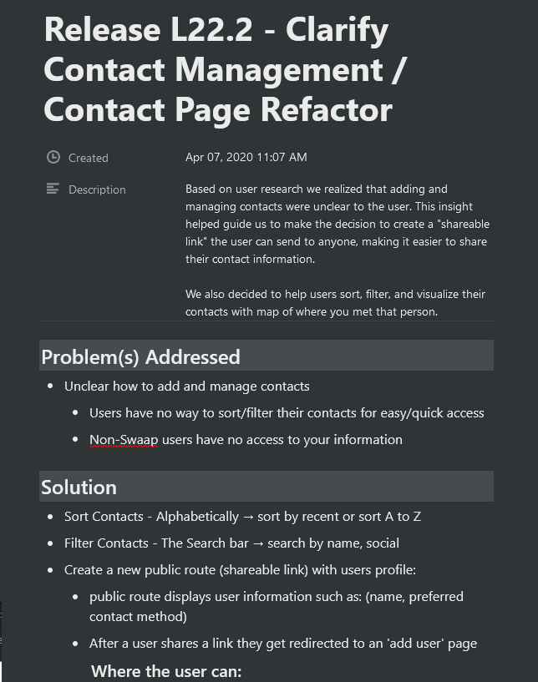
Second Release Canvas
Notes:
Our second release canvas implemented a new feature to the extent we could and solved the following sub-issues also stemming from an inconsistent user experience.

Slide 6
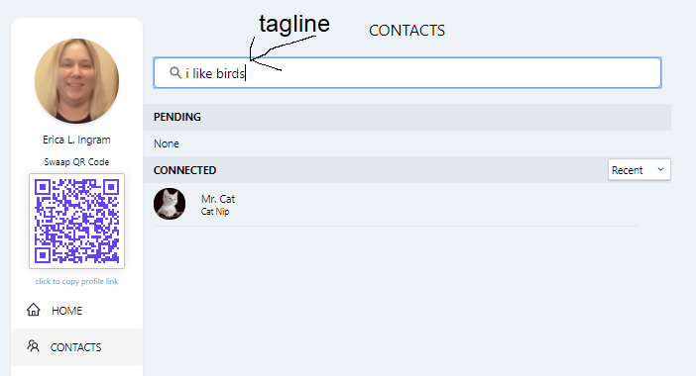
Favorite Feature
Notes:
My favorite feature was probably a tie between the search filter and the public page for non-Swaap users.

Slide 7
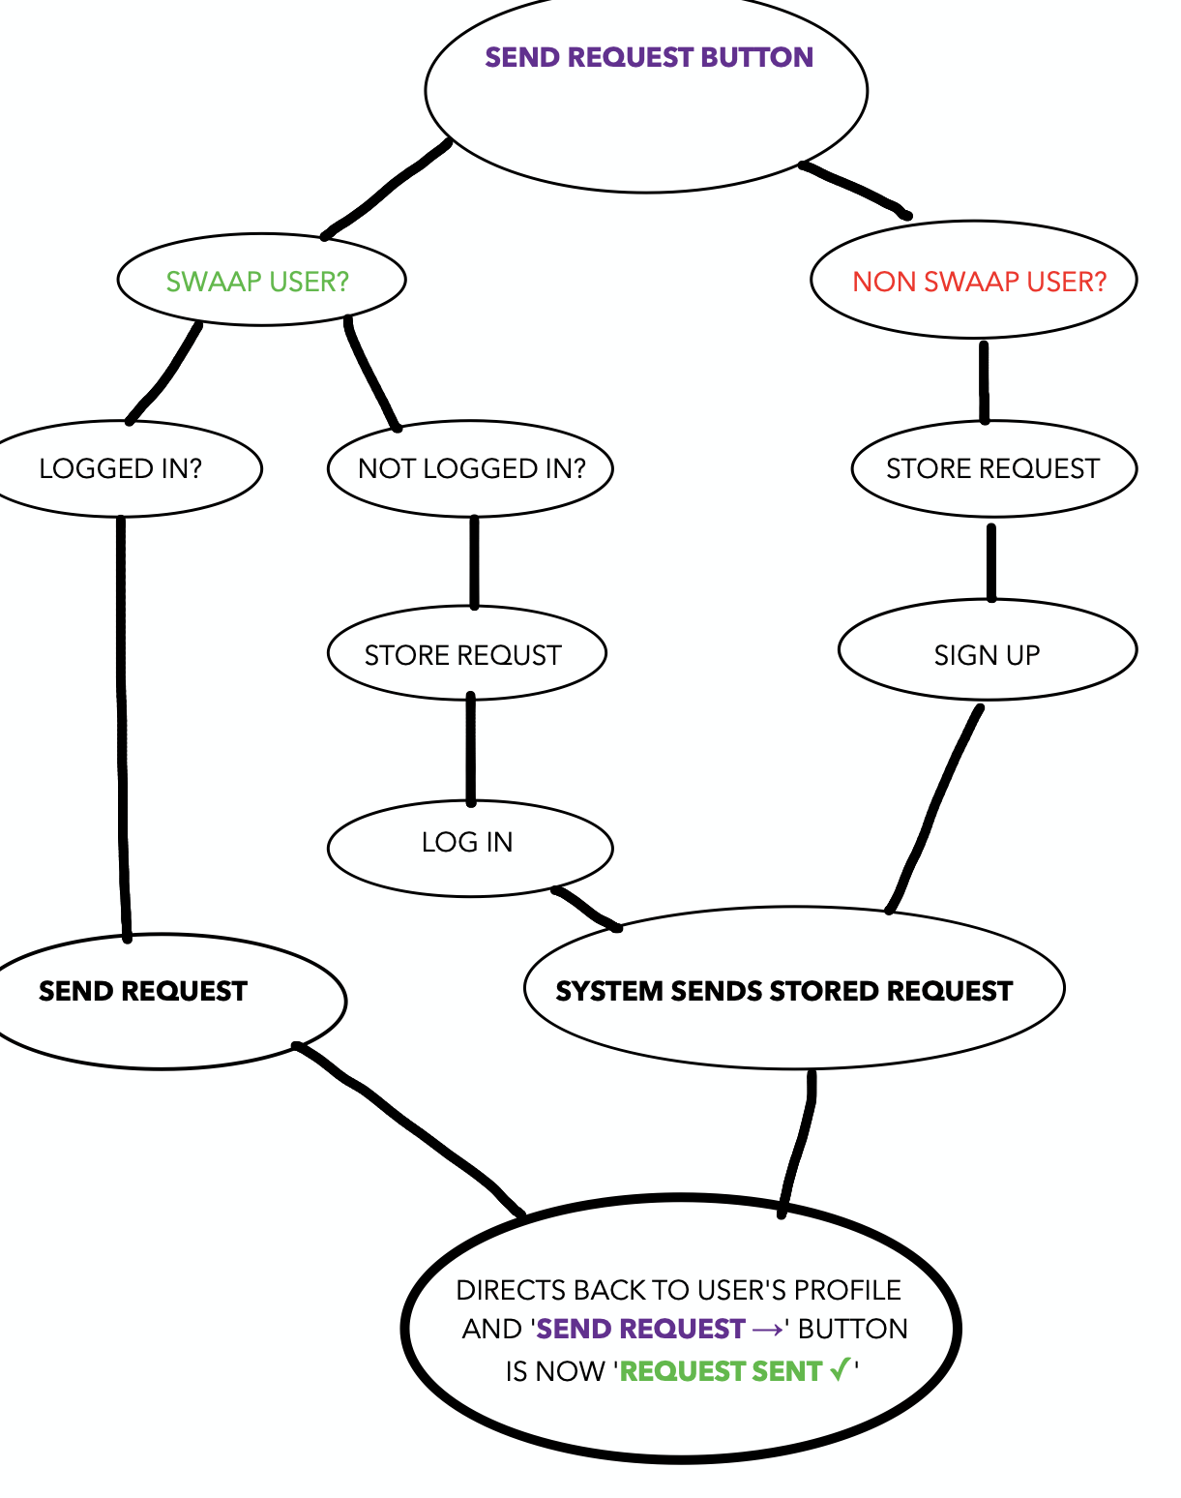
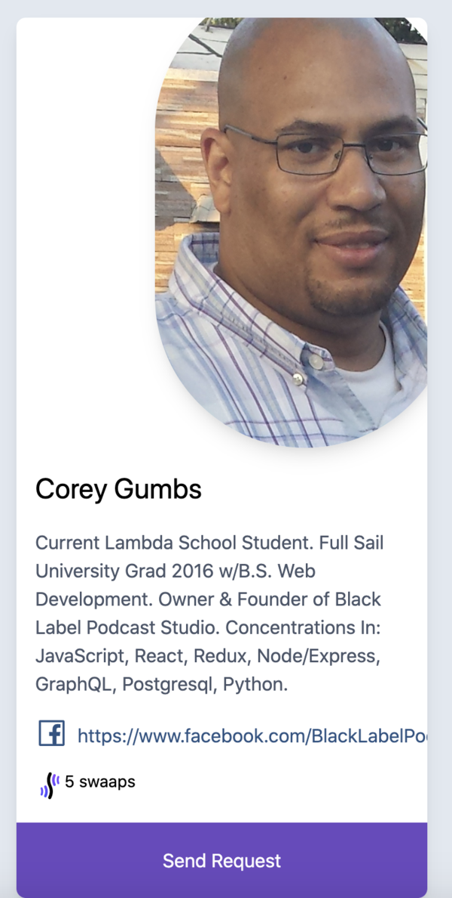
Favorite Feature
Notes:
My favorite feature was probably a tie between the search filter and the public page for non-Swaap users.

Slide 8
Testing
110 tests overall
testing via usage within group together
testing updated after refactor
covers many edge cases
Notes:
In terms of testing I wrote 110 Cypress tests, and basically started on the landing page and never made it to everything post-login due to time constraints. There was then a refactor at the end by Rob and others, so Sierra then updated the tests to ensure they still passed. When we tried to implement code climate for code coverage, there were some technical issues that we couldn't work out before Labs completed. We tested both the search filter and public page by using the app with each other while on Zoom as a team. We have at least one person on our team who likes to find ways to break things, so that works to our advantage in testing. It means the stuff we put out is strong and covers a lot of edge cases.

Slide 9
Conclusion
Problem:
Inconsistent User Experience
Solution:
Sync Web and iOS App Experiences
Steps:
Master list of differences
Set priorities
Rank differences by priority
Make selection for release canvas
Click Here to View Swaap's Product Vision Document
Notes:
So overall, both of our release canvasses greatly contributed to solving the problem of an inconsistent user experience by significantly synchronizing the web and iOS user experience and making the UI cleaner overall. We made sure we solved that problem by initially going through the entire app as a team, both web and iOS, making a master list of everything that was different, and paring it down to what you see on the release canvasses. We wanted to do a new feature integrating events, but with the time constraints being what they were, the next best thing was to create some search filters and make it easier and more enticing for non-Swaap users to use Swaap by creating public profiles, to focus more on the core feature of connecting people effortlessly.

